Slide 1
A driver behavior monitoring system using body part coordinates and AIGC
Authors: Ha Minh Tuan, Zhang Ai Ping
Office: JBD越南製造二處AI部演算法課
E-mail: ming-xun.he@mail.foxconn.com
Phone: 535-33853

Slide 2
Contents
Function point
Related patents
Past solution and disadvantages
Solutions of this proposal
Photos
Methods
Desired protection points of the patent
Advantages

Slide 3
Function point
Using an AIGC model to generate driver images with different situations
Detecting driver drowsiness with a deep learning model and a driver front view camera
Detecting a driver using a smartphone while driving according to the coordinates of the smartphone and hands in driver side view images
Detecting driver abnormal behaviors using the coordinates of body parts

Slide 4
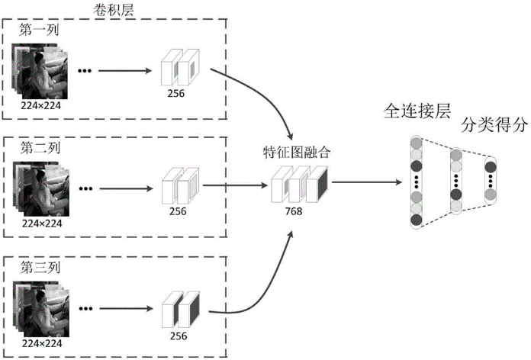
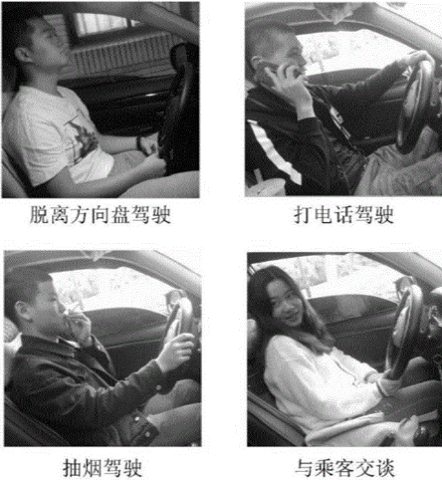
Related patents
Driver behavior identification method based on multi-scale attention convolution neural network - CN110059582B

Slide 5
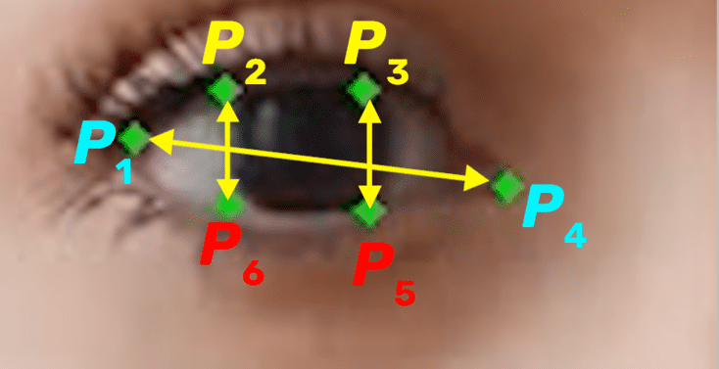
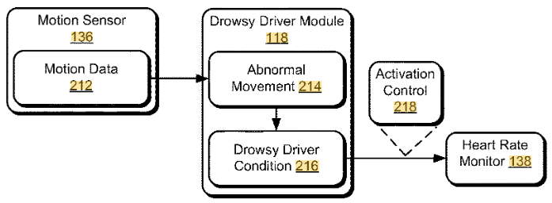
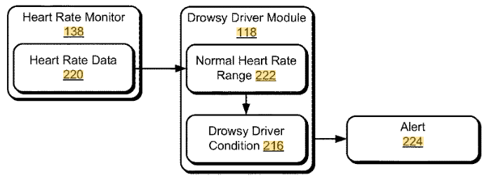
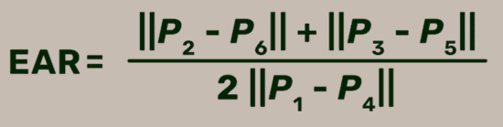
Related patents
Eye Aspect Ratio:
Drowsy detection using image processing
- AU2021103045A4
Drowsy driver detection - US9821657B2

Slide 6
Past solution and disadvantages
(1) Past solutions
Using deep learning models to identify driver behaviors
Using traditional data augmentation techniques to enrich datasets
Applying computer vision-based driver fatigue detection techniques with eye and mouth area estimation
Detecting driver fatigue with wearable sensors, analyzing heart rate, or wheel movement
(2) Disadvantages
Driver abnormal behavior is diverse, so deep learning models cannot learn all factual situations. Although they can identify common behaviors, situations that are rare, complex, or unlike any of the learned data samples can make it difficult for them.
Fatigue is hard to detect by a machine vision-based technique when the driver is wearing sunglasses or the mouth is covered with their hand. This happens because these techniques rely on recognizing facial expressions and other signs. Wearing sunglasses or covering the mouth with a hand may hide important information that the system needs to identify driver fatigue.
Using wearable sensors to detect driver fatigue is not only inconvenient but also increases the cost of the system.
These functions, which are driver drowsiness detection and behavior monitoring, have not been integrated into a unique system.

Slide 7
Solutions of this proposal
The solution of this patent is expressed through the following steps:
Installing the cameras in the cabin so that the driver's upper body, including the head, shoulders, and arms, can be seen
Collecting images of a driver in different situations, using a smartphone, wearing sunglasses, being drowsy, etc.
Designing the original dataset and training an AIGC model
Generating driver images in different situations using the AIGC and the original dataset
Using driver front view images and corresponding generated ones to design a driver front view dataset and train a driver drowsiness detection model
Detecting driver drowsiness in driver front view images
Using driver side view images and corresponding generated ones to design a driver side view dataset and train a model for detecting steering wheel and smartphones
Determining the standard posture of the driver in side view images
Detecting a driver using a smartphone while driving with coordinates of the smartphone and hands in side view images
Monitoring the driver behavior in side view images using body part coordinates

Slide 8
Photos
Image acquisition subsystem
Image processing unit
Body posture estimation model
Data storage
Driver drowsiness detection model
Steering wheel and smartphone detection model
Alerting subsystem
The structure of the proposed system

Slide 9
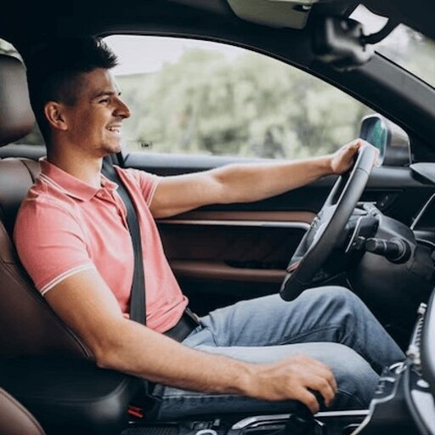
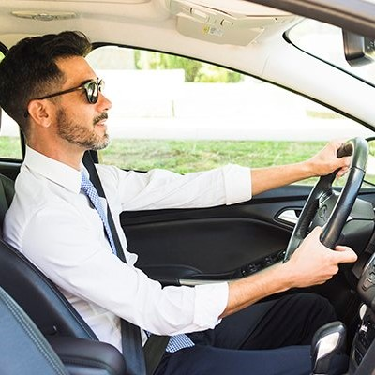
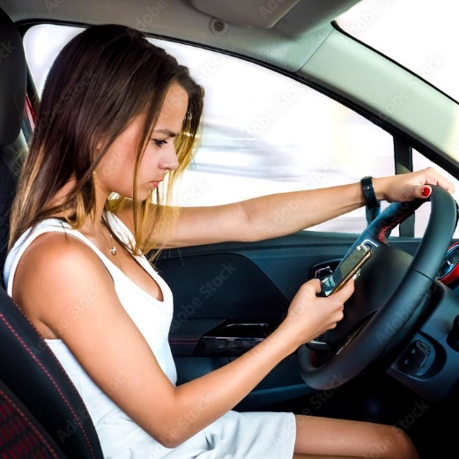
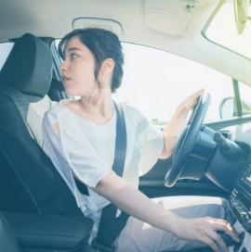
Photos
(a) Normal status
(b) Wearing sunglasses
(c) Using a smartphone
(d) Looking backward
Image collection for driver abnormal behavior detection

Slide 10
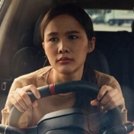
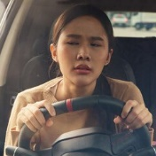
Photos
(a) Normal status
(b) Drowsy
Image collection for driver drowsiness detection

Slide 11
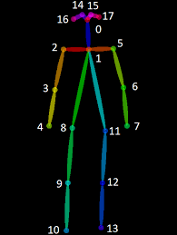
Photos
Right knee
Right foot
Left hip
Left knee
Left foot
Right eye
Left eye
Right ear
Left ear
0. Nose
Neck
Right shoulder
Right elbow
Right hand
Left shoulder
Left elbow
Left hand
Right hip
Illustration of the body model in the patent

Slide 12
Methods
4.1 Original dataset design
4.2 Training an AIGC model and generating new images of a driver in different situations using the original dataset
4.3 Driver front view dataset design and driver drowsiness detection technique
4.4 Driver side view dataset design and the technique for detecting a driver using a smartphone while driving
4.5 Driver behavior monitoring technique based on body part coordinates

Slide 13
Methods
4.1 Original dataset design
The system is installed on many vehicles to collect data. One camera is mounted in front of the driver to capture images of the driver's face and hands for drowsy detection. Another camera is installed to capture side view images of the driver, including the head, shoulders, and arms. After images of drivers in various situations are collected, such as using a smartphone, wearing sunglasses, eating, drinking, etc., they are labeled and selected for the AIGC model training set.
MOUNTING ONE CAMERA IN FRONT OF THE DRIVER AND ANOTHER ON THE RIGHT SIDE OF THE DRIVER
USING THE DRIVER FRONT VIEW CAMERA TO CAPTURE IMAGES OF A DROWSY DRIVER, WHILE THE DRIVER'S ABNORMAL BEHAVIOR IS CAPTURED BY THE DRIVER SIDE VIEW CAMERA
LABELING ALL THE COLLECTED IMAGES
DESIGNING THE ORIGINAL DATASET FOR THE AIGC MODEL

Slide 14
Methods
4.2 Training an AIGC model and generating new images of a driver in different situations using the original dataset
After setting the initial parameters, the AIGC model is trained with the original dataset. It should be noted that the images in the training dataset are collected from two different views. In particular, front view images help the model learn the Normal and Drowsy states of the driver, while the features of other driver behaviors are learned from the side view images. After the AIGC model is trained, a prompt is then fed into the AIGC model as input to generate images of a driver in the respective situations.
SETTING THE PARAMETERS FOR THE AIGC MODEL
TRAINING THE AIGC MODEL
OBTAINING THE AIGC MODEL FOR GENERATING DRIVER IMAGES
GIVING A PROMPT TO THE AIGC MODEL AS THE INPUT
GENERATING THE IMAGES OF A DRIVER IN DIFFERENT SITUATIONS

Slide 15
Methods
4.3 Driver front view dataset design and driver drowsiness detection technique
Previous image processing-based methods typically extract the driver's eyes and mouth regions from the original images. Then, the state of the driver is determined based on the proportions between the height and the width of these two objects. This method is difficult when the driver wears sunglasses and covers his/her mouth with a hand when yawning. To solve this problem, this patent uses a driver drowsiness detection model as follows. Firstly, original driver front view images and corresponding images generated by the AIGC model are used to design a driver front view dataset for an object detection model. The labels used for this model are opened-eye, closed-eye, yawning-mouth, steering wheel-holding-hand (holdng-hand for short), mouth-covering-hand, and sunglasses. After that, the model is trained using the front view dataset.
ORIGINAL DRIVER FRONT VIEW IMAGES AND THE CORRESPONDING ONES GENERATED BY AIGC MODEL
LABELING THE DATA
DESIGNING A DRIVER FRONT VIEW DATASET FOR AN OBJECT DETECTION MODEL
TRAINING THE MODEL

Slide 16
Methods
4.3 Driver front view dataset design and driver drowsiness detection technique
After training, the model is used to detect the objects in the driver front view image. If objects like closed-eye or yawning-mouth are detected, or sunglasses and mouth-covering-hand are detected, i.e. driving in a drowsy state. The system then sends an alert signal to the driver. Otherwise, no action is taken.
DETECTING OBJECTS IN DRIVER FRONT VIEW IMAGES
IF CLOSED-EYE OR YAWNING-MOUTH IS DETECTED?
FALSE
IF SUNGLASSES AND COVERING-HAND ARE DETECTED?
FALSE
TRUE
TRUE
DROWSY
DROWSY
NORMAL
ALERTING
NO ACTION

Slide 17
Methods
4.4 Driver side view dataset design and the technique for detecting a driver using a smartphone while driving
In previous studies, the situation of a driver using a smartphone while driving is often detected by an image classification model. However, because the characteristics of the driver and the location of the smartphone in the images are extremely diverse, such a model may produce wrong classifications.
To overcome this problem, this patent uses the coordinates of the hands and smartphone in the image to determine the situation. First, the original driver side view images and the corresponding images generated by the AIGC model are used to design a side view dataset for the smartphone and the steering wheel detection model. After that this model is trained. The proposed system needs to be connected to the vehicle control system to realize the vehicle's status. While the vehicle is being driven by the driver, the input driver side view image is predicted using a body posture estimation model and a smartphone detection model. If the distance between the coordinates of the smartphone and the coordinates of the hands is less than the preset value, that means the driver is using a smartphone while driving, and the system will issue an alerting signal.

Slide 18
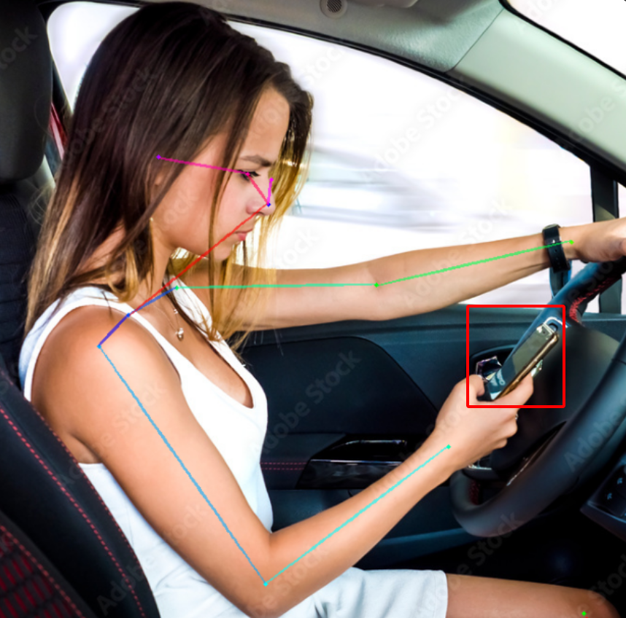
Methods
4.4 Driver side view dataset design and the technique for detecting a driver using a smartphone while driving
DRIVER SIDE VIEW IMAGES AND CORRESPONDING GENERATED ONES
DESIGNING A DRIVER SIDE VIEW DATASET
TRAINING A SMARTPHONE AND STEERING WHEEL DETECTION MODEL
FALSE
IS THE VEHICLE IS DRIVING BY THE DRIVER?
TRUE
ESTIMATING THE BODY POSTURE OF THE DRIVER
DETECTING SMARTPHONES AND STEERING WHEEL IN THE IMAGES
Illustration of the detection of a driver using a smartphone while driving
OBTAINING THE COORDINATES OF THE SMARTPHONE AND HANDS
IF THE DISTANCE BETWEEN THE
HAND AND THE SMARTPHONE IS LESS THAN A PRESET THRESHOLD?
FALSE
TRUE
NO ACTION
ALERTING

Slide 19
Methods
4.5 Driver behavior monitoring based on body part coordinates
Similar to the situation of a driver using a smartphone while driving, the abnormal behaviors of a driver, such as looking backward, drinking water, talking to passengers, etc., are often detected by an image classification model. However, the driver's abnormal postures that can lead to accidents are so diverse that the classification model cannot learn all the features of every situation. This leads to wrong results of prediction.
To overcome that challenge, this patent uses body part coordinates to classify driver behaviors. During driving, the driver's posture is monitored by the driver side view camera. With the coordinates of the steering wheel known, the standard posture of the driver in the images can be determined including the coordinates of the following parts, right ear, right eye, nose, shoulders, two hands holding the steering wheel, and the distances between the nose and hands are in range of the length of respective arms +/- 10%. Note that the standard posture of a driver must ensure the above characteristics, while the coordinates of the body parts may change. It can be seen that the coordinates of the body parts of drivers at their standard posture are not the same. Even the coordinates of the body parts of the same driver in the standard posture at each point in time are different. Therefore, during driving, the driver's standard posture is continuously determined and updated in data storage.

Slide 20
Methods
4.5 Driver behavior monitoring based on body part coordinates
During driving, the current coordinates of the body parts in driver side view images are compared with the ones in the standard posture. If the image shows the left ear without the right ear, the driver is looking backward. If both eyes and ears are visible in the image, the driver is talking to passengers. If the deviation of hands or nose to the standard locations is larger than preset thresholds, the driver may be doing an abnormal behavior such as drinking, eating, making up, smoking, etc. When the system detects the above cases, an alerting signal will be sent to the driver.
UPDATING THE DRIVER'S STANDARD POSTURE IN DATA STORAGE
COMPARING THE CURRENT COORDINATES OF THE BODY PARTS WITH THE ONES IN THE STANDARD POSTURE
LEFT EAR DETECTED BUT NO RIGHT EAR?
FALSE
BOTH EARS
AND EYES ARE DETECTED?
FALSE
DEVIATION OF HANDS OR
NOSE TO THE STANDARD LOCATIONS IS LARGER THAN PRESET
THRESHOLDS?
FALSE
TRUE
TRUE
TRUE
LOOKING BACKWARD
TALKING TO PASSENGERS
OTHER ABNORMAL BEHAVIORS
ALERTING
NO ACTION

Slide 21
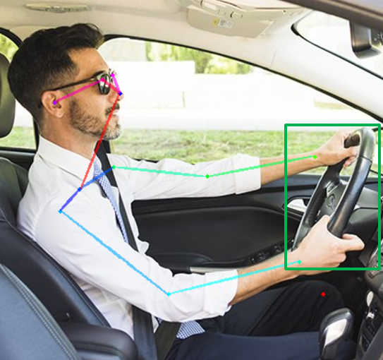
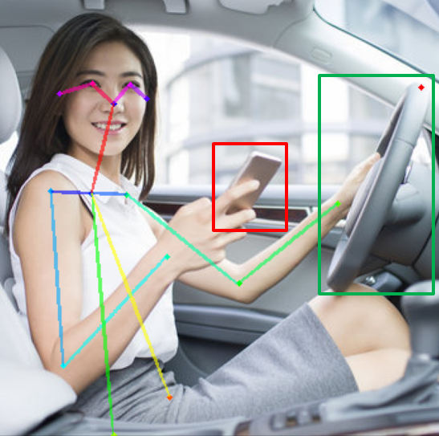
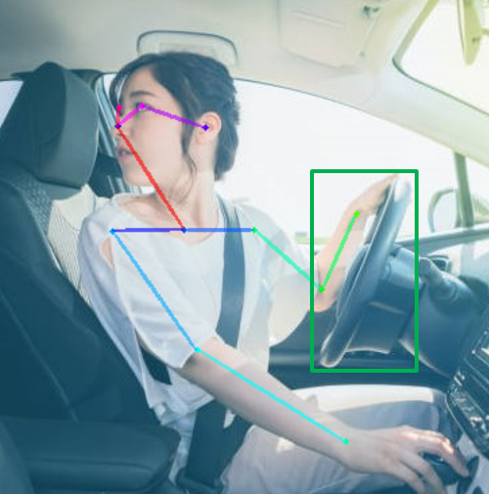
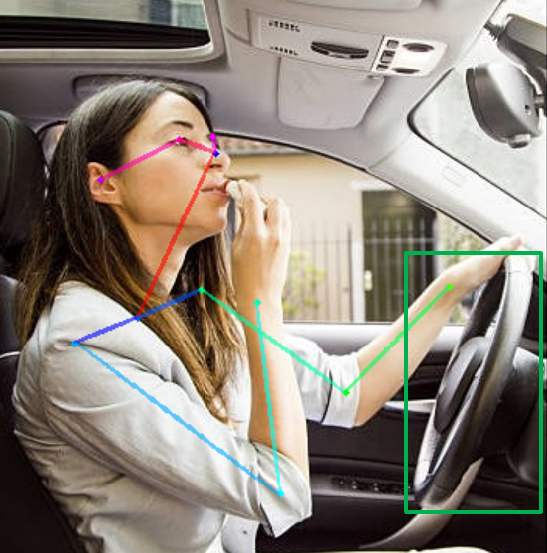
Methods
(a) Normal
(b) Talking to passengers
(c) Looking backward
(d) Making up
Illustration of driver behavior monitoring based on body part coordinates

Slide 22
Desired protection points of the patent
A driver behavior monitoring system based on body part coordinates and AIGC

Slide 23
Advantages
 | Past solutions | Our solutions
Technique | Wearable sensors EAR formula Image classification model | Object detection model Body posture estimation Object coordinates information
Efficiency | Capable of detecting only labeled abnormal behaviors | Capable of detecting even unlabeled abnormal behaviors
Novelty:
Using an object detection model to detect driver drowsiness.
Based on the body part coordinates, detect abnormal behaviors of the driver.
Creativity:
Using an AIGC model to generate images of a driver in different situations.
Detecting a driver using a smartphone while driving with the prediction results of an object detection model and a body posture estimation model.
Practicality:
Generating driver images in different situations helps reduce data collection costs.
Improving the diversity of the dataset, helping the model better predict new situations.
The comparison with the standard body posture of the driver helps to detect more types of driver abnormal behavior than previous studies.

